Slide 1
Weekly Playback
January 9th 2022
Akula Sai Bala Siva Jyothika

Slide 2
Previous Learning Schedule
As of January 9th 2023
Per Original Schedule
Per Updated Schedule
As of Today
Progress by course
AWS Cloud Practitioner
Azure
Unix Fundamentals
Database
Server&Database Monitoring
Completed
Not Completed
Completed
Not completed
Not Completed
Completed
Not Completed
Completed
Not Completed
Not Completed
Completed
Not Completed
Completed
Not Completed
Not Completed

Slide 3
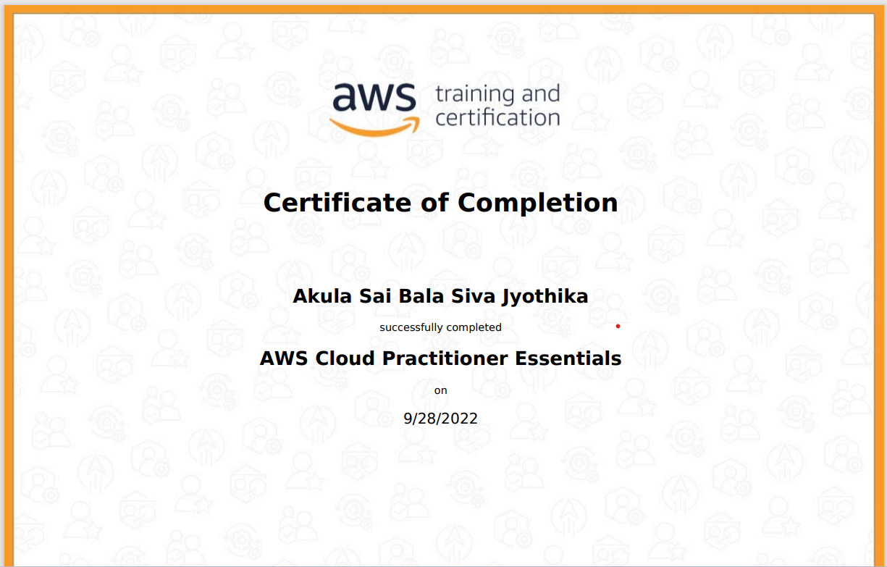




Assessment Results
Page subtitle
AWS Cloud Practitioner Essentials with Score of 85.

Slide 4
Mentor: Sudhir
Task
Set up Jenkins with master-slave Architecture.
Create a Sample pipeline.

Slide 5
Topics Covered:
AWS Cloud Practitioner:
Monitoring tools
Ec2
Unix Topics:
Unix basic commands
users, group & authentication
Unix hardening & maintainance

